Slide 1

Analysis of Hamming and Hausdorff 3D distance measures for complex pythagorean fuzzy sets and their applications in pattern recognition and medical diagnosis
Course: CSE 713
Sania Azhmee Bhuiyan
ID: 23266033
Course instructor: Annajiat Alim Rasel

Slide 2
Fuzzy Logic in Basic Terms: Fuzzy logic is a way of dealing with uncertainty and imprecision in decision-making. It is like a spectrum of possibilities, where something can be partially true and partially false.
Fuzzy logic is often used to model human reasoning and make decisions in situations where things are not strictly black and white.
Hamming Distance: Hamming distance is a measure of the difference between two strings of equal length
Hausdorff Distance: The Hausdorff distance quantifies how dissimilar two sets of points in a space are.
Fuzzy Sets: A fuzzy set is a mathematical concept that extends classical set theory. The membership function assigns values between 0 and 1, indicating the degree of membership, rather than just being a strict member or non-member.
Complex Pythagorean Fuzzy Sets: Complex Pythagorean fuzzy sets (CPyFSs) are an extension of Pythagorean fuzzy sets, which are themselves an extension of classical fuzzy sets. CPyFSs combine real numbers with complex numbers to represent not only the degree of membership and non-membership but also the degree of hesitation or neutrality in a more comprehensive way.
They are used to handle complex and uncertain information in various applications, including decision-making and pattern recognition.

Slide 3
Motivation/Purpose/Aims/Hypothesis
The paper aims to address the limitations of existing distance measures (DisMs) for complex Pythagorean fuzzy sets (CPyFSs) introduced by Ullah et al.
The motivation behind this work is to improve the handling of fuzzy information in real-life applications by proposing new DisMs based on CPyFSs.
The hypothesis is that the proposed DisMs will satisfy the axiomatic definition of complex Pythagorean fuzzy DisMs.

Slide 4
Contribution
The paper introduces a new DisM for CPyFSs by combining the 3D Hamming distance with the Hausdorff distance, demonstrating that it satisfies the axiomatic definition of complex Pythagorean fuzzy DisMs.
Additionally, the paper presents other new complex Pythagorean fuzzy DisMs. The effectiveness of these measures is illustrated through applications in building material recognition and medical diagnosis problems.

Slide 5
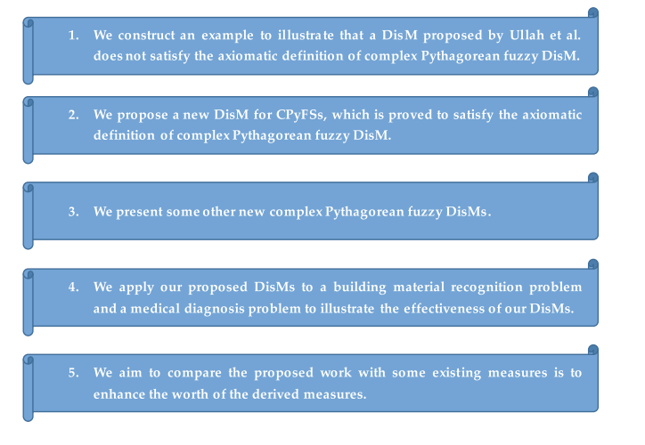
Methodology

Slide 6
Model Training for Pattern recognition
Material recognition using various similarity and distance measures
The testing revolves around the identification of an unknown building material (M) from a set of four materials (M1, M2, M3, M4) using Complex Pythagorean Fuzzy Sets (CPyFS) and related similarity and distance measures.
Seven attributes (A1, A2, A3, A4, A5, A6, A7). These attributes describe the properties of the materials.
A weight vector ω, comprising seven weight values, is used to assign different degrees of importance to the attributes

Slide 7
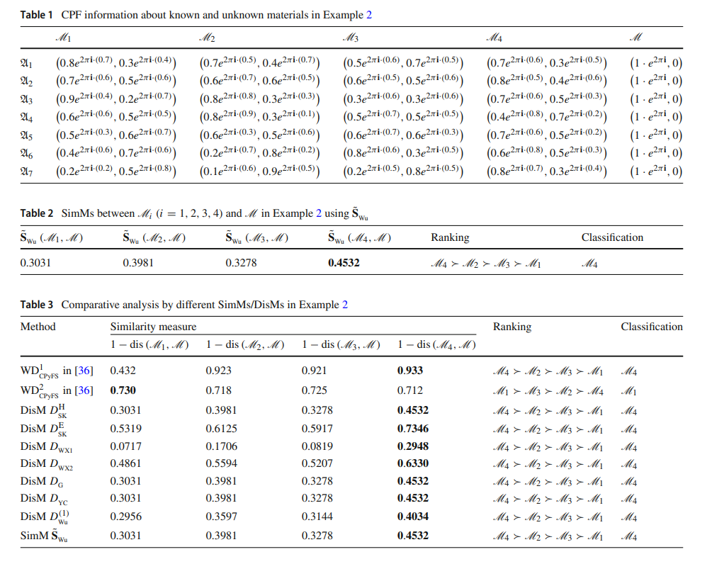
Pattern Classification Results: The results of the pattern classification using different distance and similarity measures are presented in Table 3. It is noted that the result obtained using specific measures (e.g., WD1 CPyFS) aligns with the result in Table 1.
Discrepancy in Results: An important finding is that one particular distance measure (WD2 CPyFS) is mentioned as unreasonable because it does not satisfy the axiomatic definition of complex Pythagorean fuzzy distance measures.

Slide 8
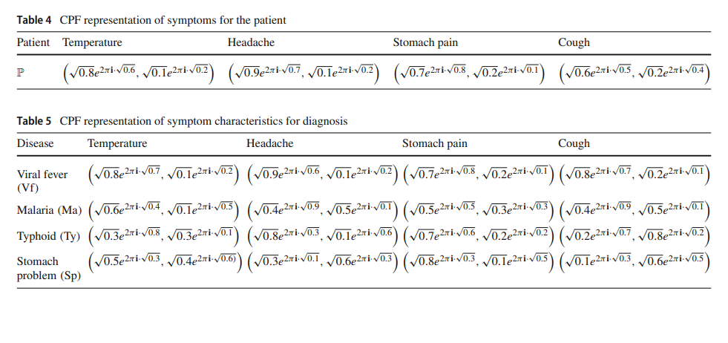
Model Training for Medical Diagonosis
A medical diagnosis problem was addressed
Medical symptoms (S) and diagnostic characteristics (D) were represented using Complex Pythagorean Fuzzy Numbers
Diagnostic Result: The maximum degree of Similarity Measures (SimMs) was employed to diagnose the patient (P). The result was that the patient suffered from 'Viral fever’. The diagnostic result aligns with the outcome of the problem as per the Complex Pythagorean Fuzzy predictions.
Discrepancy in Results: They were found to have limitations in resolving some selected information.

Slide 9
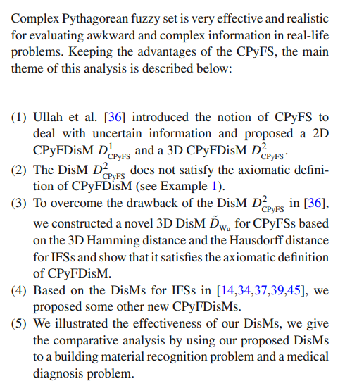
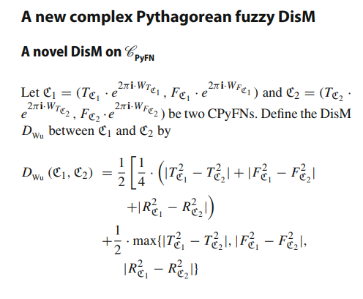
Conclusion

Slide 10
2. Limitations
2.1 First Limitation/Critique
one particular distance measure (WD2 CPyFS) is mentioned as unreasonable because it does not satisfy the axiomatic definition of complex Pythagorean fuzzy distance measures, a discrepancy in the result.
2.2 Second Limitation/Critique
exploring additional mathematical and aggregation operators to improve the versatility and utility of CPyFS in various domains such as road signals, computer networks, game theory which were not discussed in the paper

Slide 11
3. Synthesis
The ideas presented in the paper primarily revolve around the development of new distance measures for complex Pythagorean fuzzy sets (CPyFSs) to improve the handling of fuzzy information in real-life applications.
Applications in building material recognition and medical diagnosis. The paper's findings provide valuable tools for decision-making and pattern recognition within the CPyFS framework.
In summary, the paper contributes to the field of complex fuzzy sets by introducing new distance measures that address the limitations of existing approaches, making them suitable for applications involving fuzzy information in various domains.

Slide 12
THANK YOU

